Slide 1

Relationships and Sex Education (RSE) at Broomgrove Junior School

Slide 2
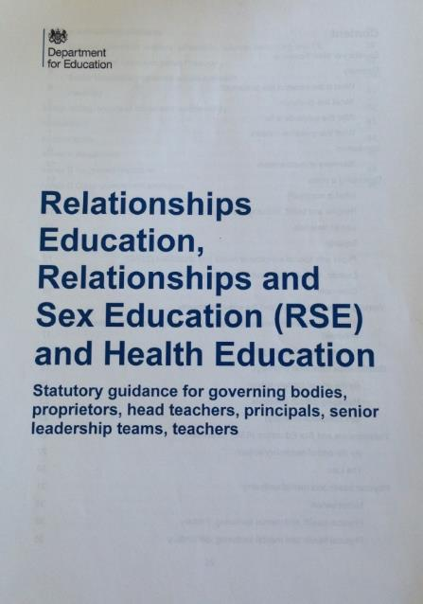
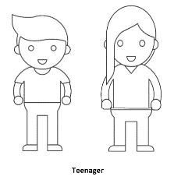
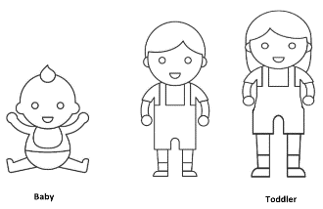
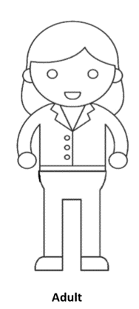
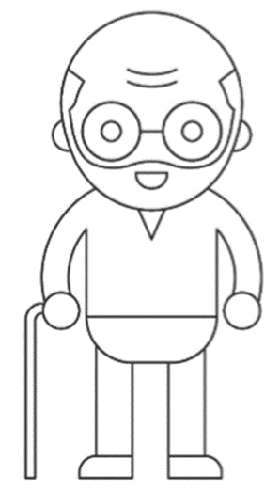
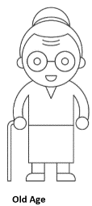

Why we’re here!
Notes:
New guidance on Relationships and Sex Education has come out. The last time this was updated was back in the year 2000, which is over 20 year ago. A lot has changed in this time, and the new guidance reflects this.

Slide 3
“This compulsory subject has been introduced to help to keep children safe;
prepare them for the world in which they are growing up, including the laws as they relate to relationships, sex and health;
to help foster respect for others and for difference.”
Damian Hinds – Secretary of State for Education
February 25th 2019
Notes:
Remind ourselves of the reasons why the RSE and Health Ed has become statutory.
1st March 2017 that the then Ed Sec, Justine Greening, announced changes to statutory status of RSE
Children and Social Work Act, March 2017
The guidance needs to relate to the modern world, making sure that children and young people are taught how to navigate the modern world safely both on and offline. About keeping children safe and acknowledging that the world has changed dramatically since we were children.

Slide 4

Relationships and sex education
Relationships and sex education (RSE) is an important part of PSHE education. Relationships education is compulsory for all primary school pupils, and relationships and sex education (RSE) is compulsory for all secondary school pupils.
Advice for schools
We provided grant funding to the PSHE Association to advise schools in developing their own PSHE curriculums and improve the quality of teaching. The association focuses on signposting schools to resources and in expanding their Chartered Teacher of PSHE programme. We also asked the Association to promote the teaching of consent as part of SRE, in line with the 2000 statutory guidance.

Slide 5
The guidance states:
Schools have been teaching RSE/RE from September 2020, with schools encouraged to begin teaching earlier.
All primary schools in England teach ‘Relationships Education’
All secondary schools teach ‘Relationships and Sex Education’
Notes:
Statutory status from September 2020.
Relationships Education is statutory in primary schools and the DfE strongly encourages them to continue teaching age appropriate sex education.

Slide 6
Primary – Parents retain the right to withdrawal from sex education, unless the lesson is part of the National Curriculum for Science.
Flexibility for schools in their approach.
At Broomgrove Junior School we teach RSE through our PSHE and science programmes. Effective relationships are discussed and encouraged at all levels – with the core values of love, care and respect for all being part of our ethos. Sexual relations are discussed in the context of marriage or stable relationships and self-respect and respect for others constantly.
Notes:
Parents withdrawal:
Primary schools- Head teachers will automatically grant a request to withdraw a pupil from any sex education delivered in primary schools, other that as part of the NC science curriculum. However it is best practice to invite parents who are considering withdrawing their child to discuss their concerns and allay their fears, in case a withdrawal is being made on untruths about what is being taught.

Slide 7
What does the guidance say about parents?
Parents (and carers) are the prime educators for children on …these matters. Schools complement and reinforce this role…building on what pupils learn at home...
Parents have the right to request that their child be withdrawn from some or all of sex education that primary schools to deliver, unless the lesson is linked to the National Curriculum for Science.
Schools must consult parents in developing and reviewing their RSE policy.
Notes:
Once schools have developed their RSE policy it is important that they share it with parents and make it accessible via their website. Involving parents in the process of reviewing the policy ensures they understand how Relationships (and Sex) Education will be delivered in your school.

Slide 8
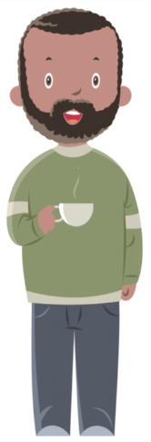

Schools should… ensure that…they provide examples of the resources that they plan to use (as part of RSE) as this can be reassuring for parents and enables them to continue the conversations started in class at home.
Schools should ensure that parents know what will be taught and when.
Parents should be given every opportunity to understand the purpose and content of Relationships (and Sex) Education. Good communication and opportunities for parents to understand and ask questions about the school’s approach help increase confidence in the curriculum.
Notes:
Really important that parents have an opportunity to see resources as this can help them continue conservations at home using the same language

Slide 9

This year, we have started using the PSHE Association Scheme of Work for PSHE and RSE
Overall Topic Foci:
Health and Wellbeing
Relationships (incorporating RSE Units)
Living in the Wider World

Slide 10
BGJS PSHE PROGRAMME OF STUDY: LONG-TERM OVERVIEW 2023-2024
Core Themes of Study: | Health and Wellbeing |  | Relationships |  | Living in the Wider World
 | Autumn 1 | Autumn 2 | Spring 1 | Spring 2 | Summer 1 | Summer 2
Year 3 | How can we be a good friend? | What keeps us safe? | What are families like? | What makes a community? | Why should we eat well and look after our teeth? | Why should we keep active and sleep well?
Year 4 | What strengths, skills and interests do we have? | How do we treat each other with respect? | How can we manage our feelings? | How will we grow and change? | How can our choices make a difference to others and the environment? | How can we manage risk in different places?
Year 5 | What makes up a person’s identity? | What decisions can people make with money? | How can we help in an accident or emergency? | How can friends communicate safely? | How can drugs common to everyday life affect health? | What jobs would we like?
Year 6 | How can we keep healthy as we grow? |  | How can the media influence people? |  | What will change as we become more independent? How do friendships change as we grow?
This year, all RSE Units are taught in Summer 2

Slide 11
Statutory requirements for RSE
The BGJS lesson plans for RSE come from the PSHE Association Programme of learning which have been updated to reflect the Department for Education (DfE)’s statutory requirements to teach Relationships Education and Health Education at key stages 1 and 2. The lessons support schools to cover elements of statutory Relationships and Health Education, including the topic of puberty in years 4, 5 and 6. Parents and carers do not have the right to request to withdraw their children from the lessons on Relationships and Health education.
In the DfE statutory guidance it states, ‘puberty including menstruation should be covered in Health Education and should, as far as possible, be addressed before onset’. For this reason, the lesson plans on puberty are aimed at pupils in year 4 or year 5, so they are prepared for the changes they and their peers will experience.
In Year 6, Lesson 4 How a baby is made incorporates elements of Sex Education and has been included to provide a comprehensive programme of Relationships and Sex Education (RSE), to safeguard pupils effectively and to provide a foundation for later learning on healthy intimate relationships. While the Department for Education strongly recommends that primary schools deliver Sex Education, our school has judged that parents/carers have the right to request to withdraw their children from this lesson.

Slide 12
RSE (Relationships and Sex Education) and Science Overview 2023-2024
 | RSE | Science- Outstanding Science (Part of the Statutory National curriculum )
Year 3 | 1. What makes a good friend? We are learning about friendship, including why it is important and what makes a good friend 2. Falling out with friends. We are learning how to maintain good friendships and about solving disagreements and conflicts with peers | Animals, Including Humans Food groups Animals and their food Food chains Food webs The human skeleton Muscles for moving Animals and their Skeleton Types of skeleton
Year 4 | 1. Puberty: personal hygiene. We are learning about the importance of personal hygiene during puberty 2. Puberty: emotions and feelings. We are learning about emotional changes during puberty | Animals, Including Humans Digestive system, organs The human digestive system Types of teeth Tooth structure Looking after our teeth Food chains Food webs

Slide 13
RSE (Relationship and Sex Education) and Science Overview 2023-2024
Year 5 | 1. Puberty: time to change. We are learning about the physical changes that happen during puberty 2. Puberty: menstruation and wet dreams. We are learning about the biological changes that happen during puberty | Animals, Including Humans Gestation periods Foetal development Child development Child responsibility Puberty Men and women Old age Timeline of a human life
Year 6 | 1. Puberty: recap and review. We are learning about the changes that happen during puberty (recap from year 4-5) 2. Puberty: change and becoming independent. We are learning about managing change and becoming more independent 3. Positive and healthy relationships. We are learning about positive, healthy relationships 4. How babies are made. We are learning about how a baby is made. | Animals, Including Humans Blood The human circulatory system The human heart Investigating heart rate Alcoholic drinks The effect of smoking Diet and exercise The benefits of exercise

Slide 14
The Relationships units cover the following topics:
Families and communities
Caring friendships
Respectful relationships
Online relationships
Being safe
Notes:
This shows the Relationships Education Units.
The focus in primary schools will be on healthy, respectful relationships, concentrating on family and friendships, on and offline.
The proposed new curriculum will cover issues such as talking about emotions, online safety, body image, consent and harassment (in an age-appropriate way), stereotypes, respect and self-respect, tolerance and trust. A summary of each topic:
Families and people who care for me: acknowledging that families are important and provide love, security and stability, what a healthy family life looks like, that sometimes families look different, that these differences should be respected and that these families also provide care and love, and being able to recognise if a family relationship is making them feel unhappy or unsafe and who to talk to.
Caring Friendships: how important friendships are, how to choose and make friends, the characteristics of friendships, that most friendships have ups and downs and how to manage this, how to recognise who to trust and not to, and if a friendship is making them feel unhappy or sad, who to talk to.
Respectful relationships: importance of respecting others even when they are different from us and having self respect, learning about different types of bullying and the responsibilities of bystanders, knowing about stereotypes and permission seeking.
Online relationships: sometimes people behave differently online, need to behave respectfully online as you do offline, keeping safe and reporting harmful content, critically consider online friendships and sources of information.
Being safe: different types of boundaries between friendships, peers and others, concept of privacy, differences between appropriate and inappropriate touch or unsafe contact, how to respond safely and appropriately to adults, how to recognise and report unsafe or feeling bad about an adult, how to report concerns or abuse and the vocabulary and confidence to do so, where to get advice.

Slide 15
Relationships and Sex Education units cover the following topics:
Mental Wellbeing
Internet Safety and harms
Health and prevention
Changing adolescent body
A closer look at the programme …
Notes:
Health Education compulsory in all state funded schools but NOT independent schools.
In the guidance the Health Education curriculum covers a number of outcomes related to and reinforcing Relationships Education, including:
Emotions and feelings, simple self care techniques, seeking support from a trusted adult, bullying including cyberbullying, and respectful online behaviour, as well as puberty.
Mental wellbeing- very much related to feelings- helps children work out if something feels right or not. Related to safeguarding.
Internet Safety and Harms- reinforces and supports work delivered regarding online relationships
Health and Prevention-Personal hygiene and germs including bacteria, viruses, how they are spread and the importance of hand washing.
Changing adolescent body-
The guidance states that:
“Puberty should be covered in Health Education and should be addressed before the onset so, as far as possible, pupils are prepared in advance for changes they will experience.”
Content should include:
- Key facts about puberty and the changing adolescent body, particularly from age 9 through to age 11, including physical and emotional changes
Many believe that girls as young as 8 are starting their periods, but recent data shows girls as young as 7 can start their periods. Girls turn 7 in Year 2. Guidance states pupils are prepared in advance.

Slide 16
Misconceptions about RSE
1. It is teaching our young children how to have sex.
3. RSE will mean children are more likely to start having sex and relationships earlier, as it is encouraged.
2. Children are too young for RSE.

Slide 17
Misconceptions about RSE
1. It is teaching our young children how to have sex.
Incorrect:
Sex Education – the curriculum is based on science. Children learn the biological reasons for reproduction and the scientific terms for their body parts.
Relationships Education – this part of the curriculum focuses on equality and respect for all types of families and relationships. It is in line with the law of the U.K which recognises all relationships and all families.

Slide 18
Misconceptions about RSE
2. Children are too young for RSE.
Incorrect:
The curriculum we use as a school is based on the PSHE Association Programme of Learning and has been designed with the age of the children in mind. No content is taught too early for children to understand. It is important that RSE is normalised from an early age, and that it is seen as a scientific part of life.

Slide 19
Misconceptions about RSE
3. RSE will mean children are more likely to start having sex and relationships earlier, as it is encouraged.
Incorrect:
Research shows that as children get older, they are more likely to delay relationships and sexual experiences because they have been taught the right information to make safe and responsible decisions. RSE is a safeguarding issue. Children are more likely to report abuse, more likely to engage in safe relationships and make safer decisions with effective RSE.

Slide 20
Next steps…
This PowerPoint will be published on to the website.
The school, once we have carried out both consultations, will write the new RSE policy.
RSE teaching will start from Monday 17th June).

Slide 21
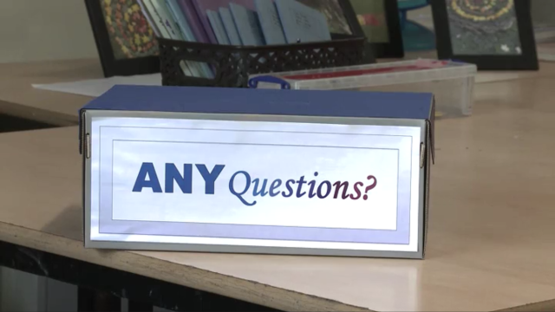

Slide 22
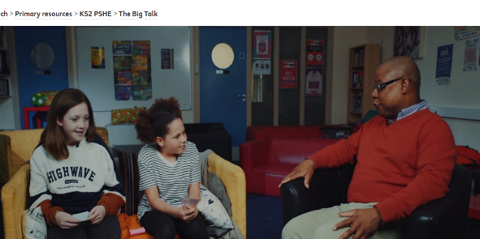

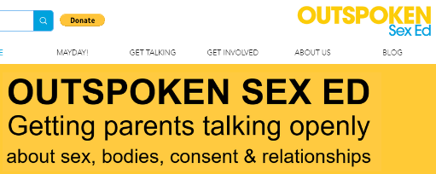
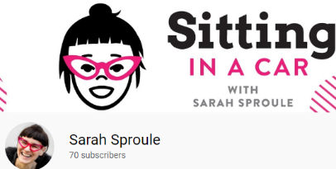
BBC Teach- The Big Talk
Amaze Junior
Sarah Sproule
Outspoken Sex Ed

